Slide 1
AI-Driven Pneumonia Prediction: A Data-Centric Approach Using Machine Learning
Daniel Akama Nyamweya
SAT 5114

Slide 2
Problem Statement
Pneumonia remains a leading cause of morbidity and mortality worldwide, making early detection and prediction is crucial for improving patient outcomes.
This research explores the application of artificial intelligence (AI) in pneumonia prediction using structured clinical datasets.
By leveraging machine learning techniques, the study aims to develop a predictive model capable of identifying pneumonia risk based on patient demographics, symptoms, laboratory results, and other relevant features.

Slide 3
Our Approach: Dimensionality Reduction + Predictive Modeling
Goal: Build a predictive model for pneumonia using patient data.
Challenge: The dataset has 70+ features, which can lead to noise and overfitting.
Solution: Applied PCA to reduce dimensionality while preserving variance.
Model: Training base models i.e. Logistic regression and Ensemble models.

Slide 4
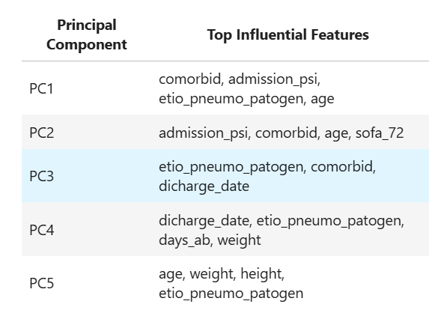
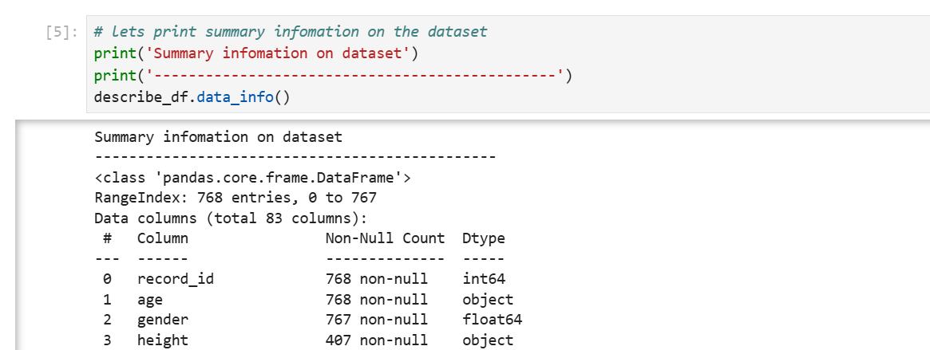
Code Highlights: Before and after applying PCA to dataset

Slide 5
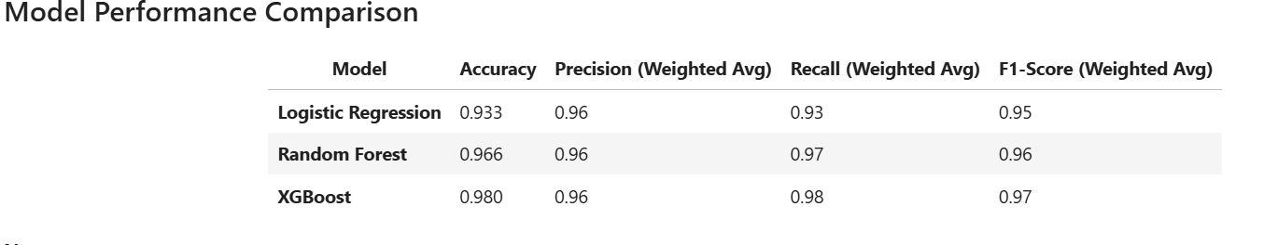
Performance Metrics

Slide 6
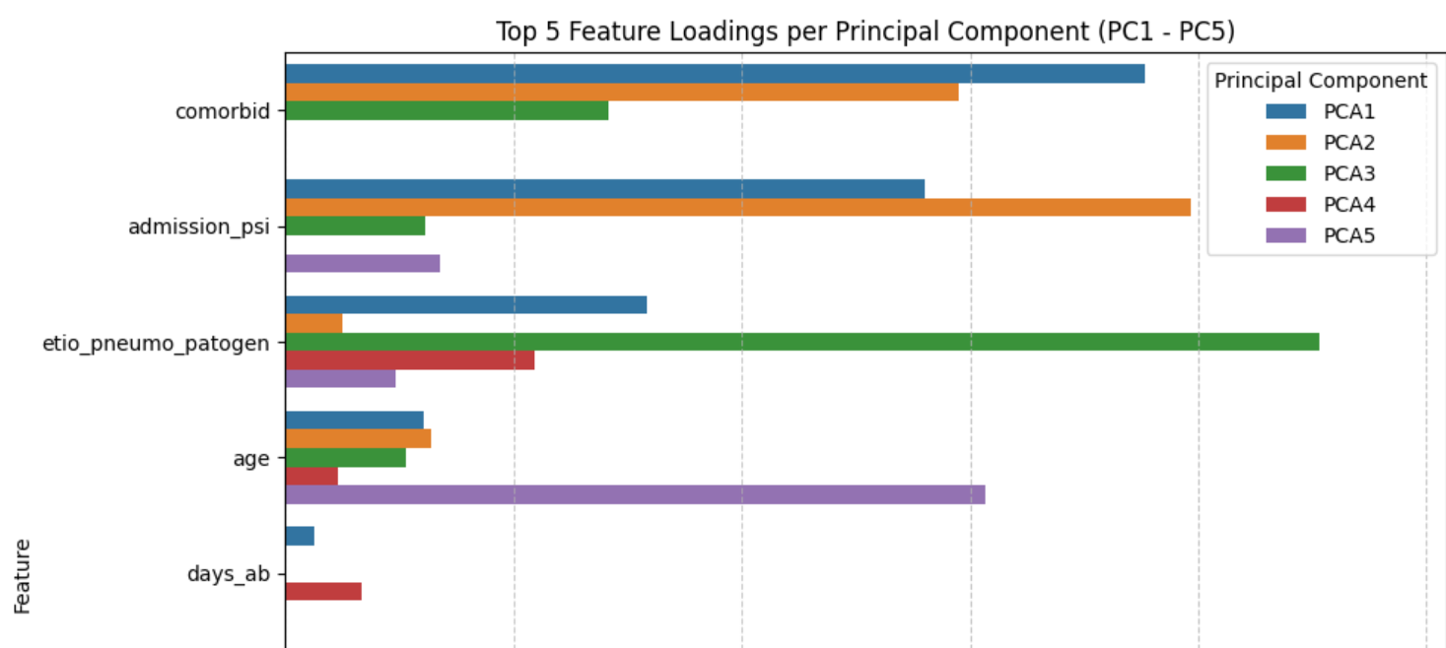
PCA components

Slide 7
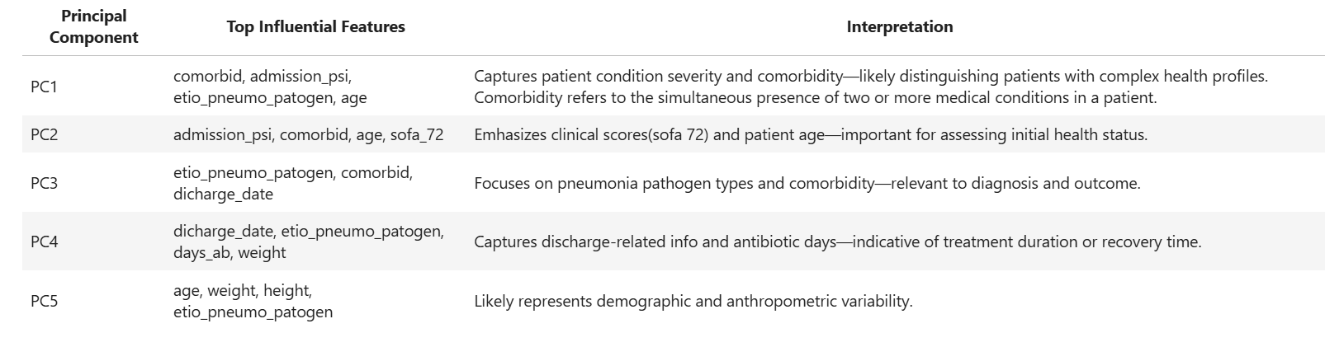
PCA components

Slide 8
Conclusion
Models performed well though they significantly favoured the majority class even after applying SMOTE.
This project was a gateway into advanced AI in Pneumonia research, it proved that clinical data can also be applied to detecting pneumonia to some extent.

Slide 9
Future Direction
Combine Structured clinical data with image based data for predictive modeling.
Apply deep learning techniques such as transfer learning to curb the issue of lack of data.
Apply Federated Learning, to expose the model to diverse data for enhanced generalizability.
Deployment. This involves scaling the project to a full-fledged application.

Slide 10
Thank you

